Slide 1
Forecasting Challenge

Slide 2




our
team
Scott Frank Data Analyst
Marcie Wallace Data Analyst
Sara Song Data Analyst
Praneeth Reddy Bonthu Data Analyst

Slide 3

agenda
introduction
business problem
analytics problem
data exploration
forecast methods
result
summary

Slide 4
about overstock
Online retailer founded in 1999
Publicly traded
Headquartered in Midvale, Utah
~ 2,000 employees
Heavy investment in AI and ML

Slide 5
customer service at overstock
Three Call Center Locations
Midvale, UT
North Salt Lake, UT
Evergreen, WA
Four Channels
Phone calls
Emails
Online chats
SMS messages
Daily Interactions
25,000 customer interactions
10,000 inbound calls
2,500 outbound calls
10,000 emails answered

Slide 6
business problem
To optimize responsiveness and cost, we need to achieve this landmark:
Schedule Optimization
How many agents will we need on the floor to handle the calls coming in?
Constraints
60 days out - must lock in 30 days of schedule
Underestimates - must pay at least 85% of contract
Overestimates - over 110% at 1.5x cost

Slide 7
data
Available Data
Call details
Workgroup details
Incident details
Sales details

Slide 8
analytics problem
To optimize responsiveness and cost, we need to achieve this landmark:
Contact Forecasting
How many contacts will we receive and when will we receive them (day of week)?
Given what has happened in the past, what do we predict for the future?
Forecasting methods naïve models, mean model, fbprophet and ARIMA

Slide 9
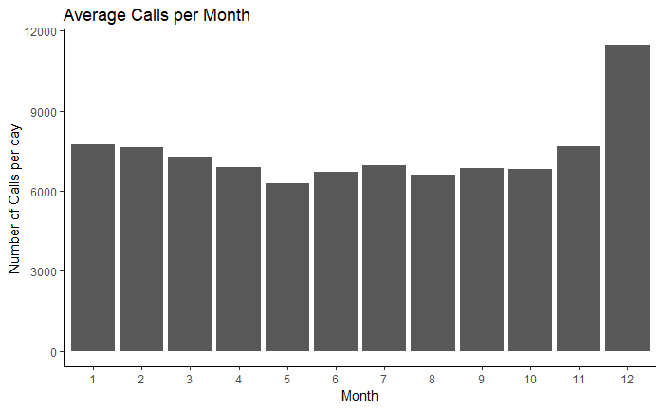
data exploration
Avg. calls for December is 55% above the yearly average.
Notes:
Average Jan 7749, Feb 7647, Mar 7277, Apr 6879, May 6291, June 6706, July 6952, Aug 6610, Sept 6853, Oct 6812, Nov 7678, Dec 11469

Slide 10
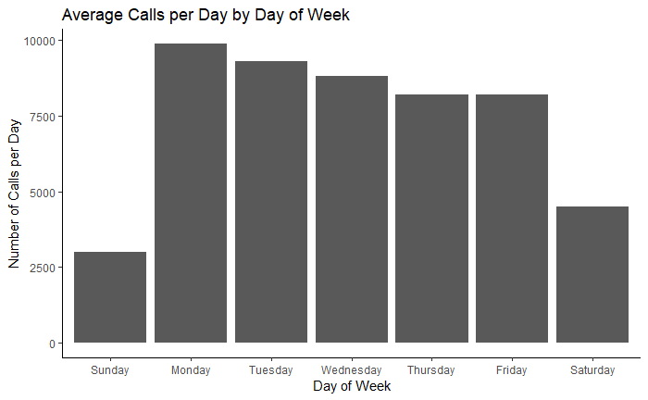
data exploration
Avg. Calls for weekday is 2.4x that of weekend
Notes:
Average Sunday 2985, Monday 9881, Tuesday 9296, Wednesday 8810, Thursday 8207, Friday 8190, Saturday 4495

Slide 11
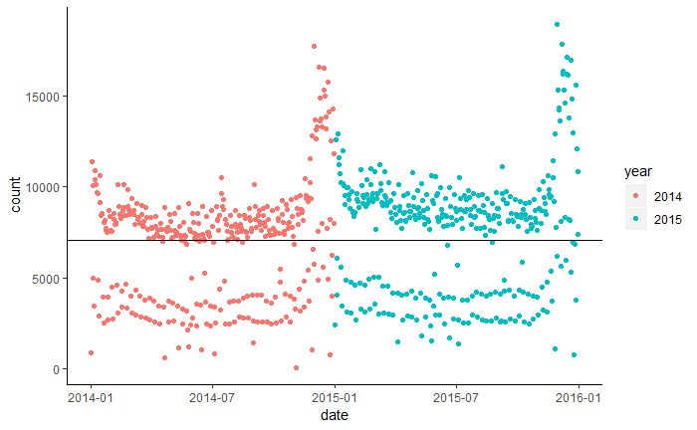
mean model
Using average call volume in 2014 to predict call volume in 2015
Black line shows average call volume for 2014
Notes:
Average line 8453.111

Slide 12
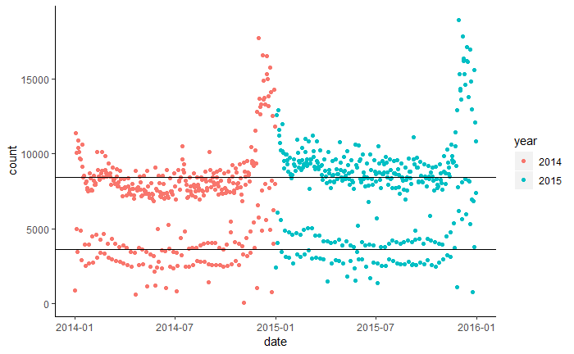
mean model
Mean model doesn’t consider the variation in avg. call volume between weekday and weekend
weekday
weekend
Black lines show average call volume in 2014 for weekday and weekend
Notes:
Average line 8453.111

Slide 13
naive models
Forecasting Methods
Yesterday
Naïve model which predicts call volume based on call volume yesterday
Last Year
Naïve model which predicts call volume based on this day (corresponding day of week) last year
Last year model outperforms yesterday model, since there is a variation in avg. call volume between weekday and weekend.

Slide 14
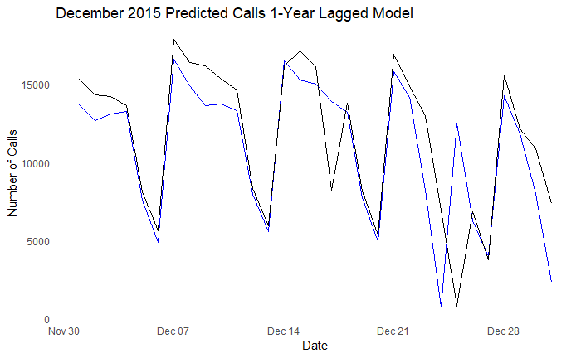
naive last year model
Average daily call volume in Dec 2015 predicted using call volume from 2014
Black – actual call volume; Blue – predicted call volume

Slide 15
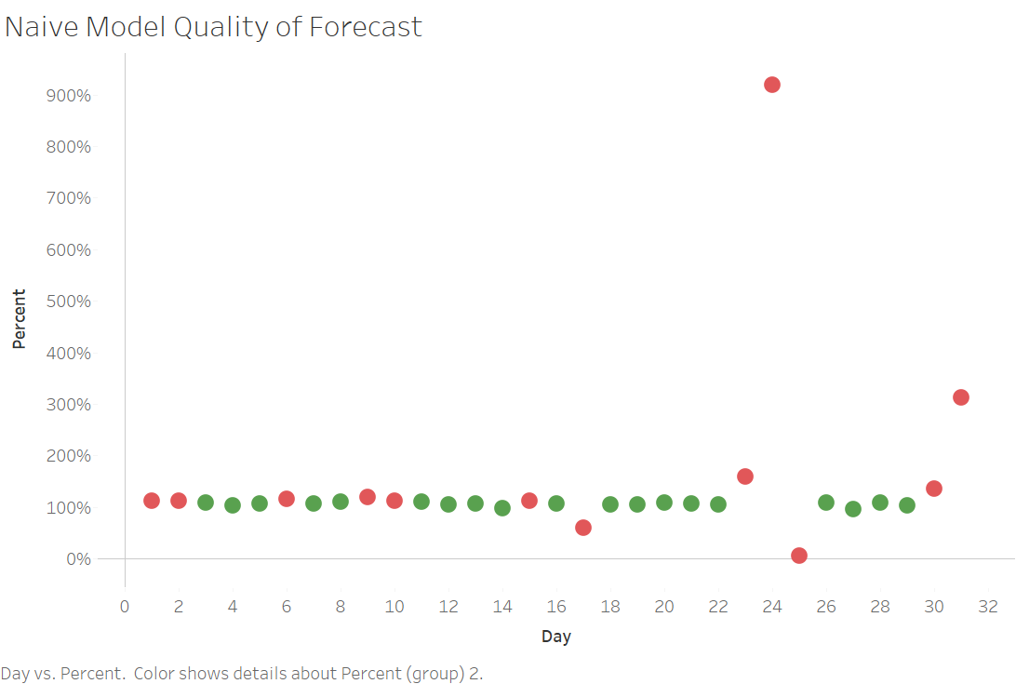
naive last year model
For 19/31 days, the predicted number of calls were within the acceptable error range
Percentage error of predictions by day
Green – actual is within 85% - 110% of prediction
Red – actual is outside acceptable error range

Slide 16
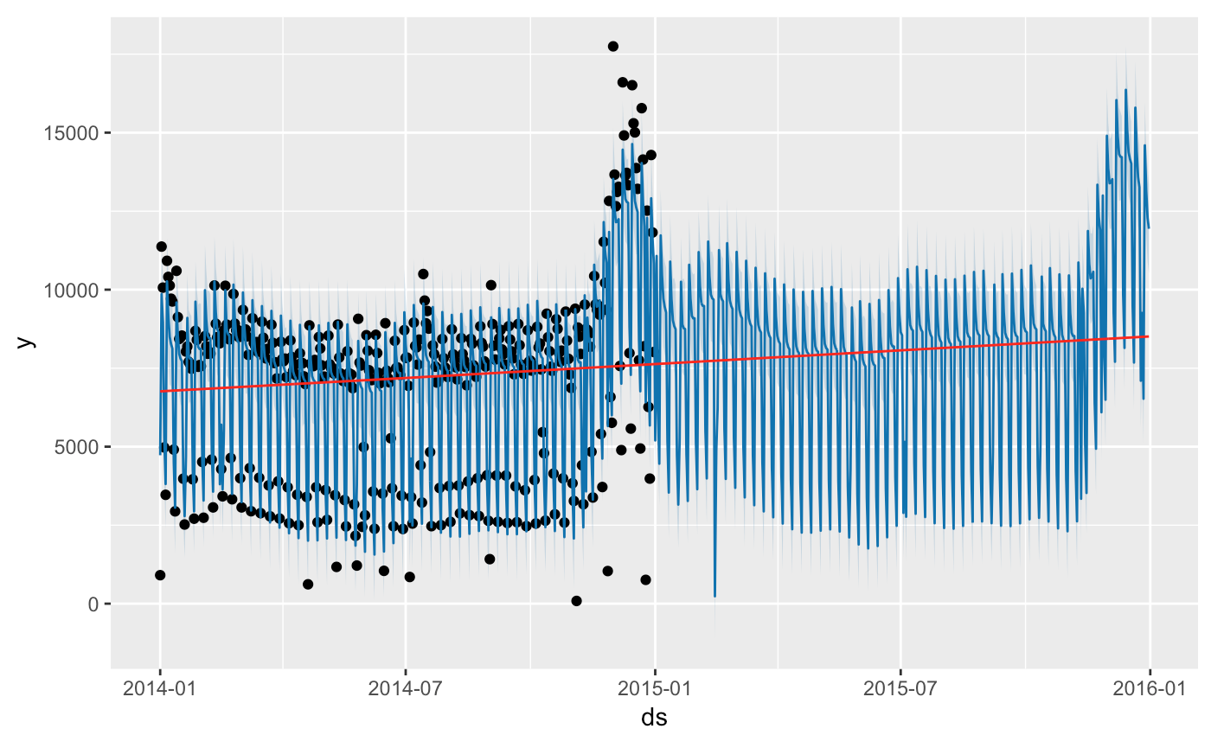
prophet model
Time Series Result Plot
Black points – actual volume 2014
Blue lines – predicted call volume
Red line – overall trend

Slide 17
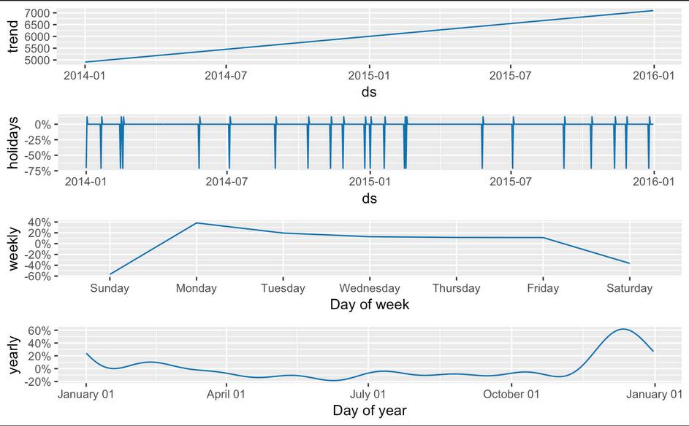
prophet model
This plot shows the effect of holidays, weekly and yearly seasonality, associated with the call volume

Slide 18
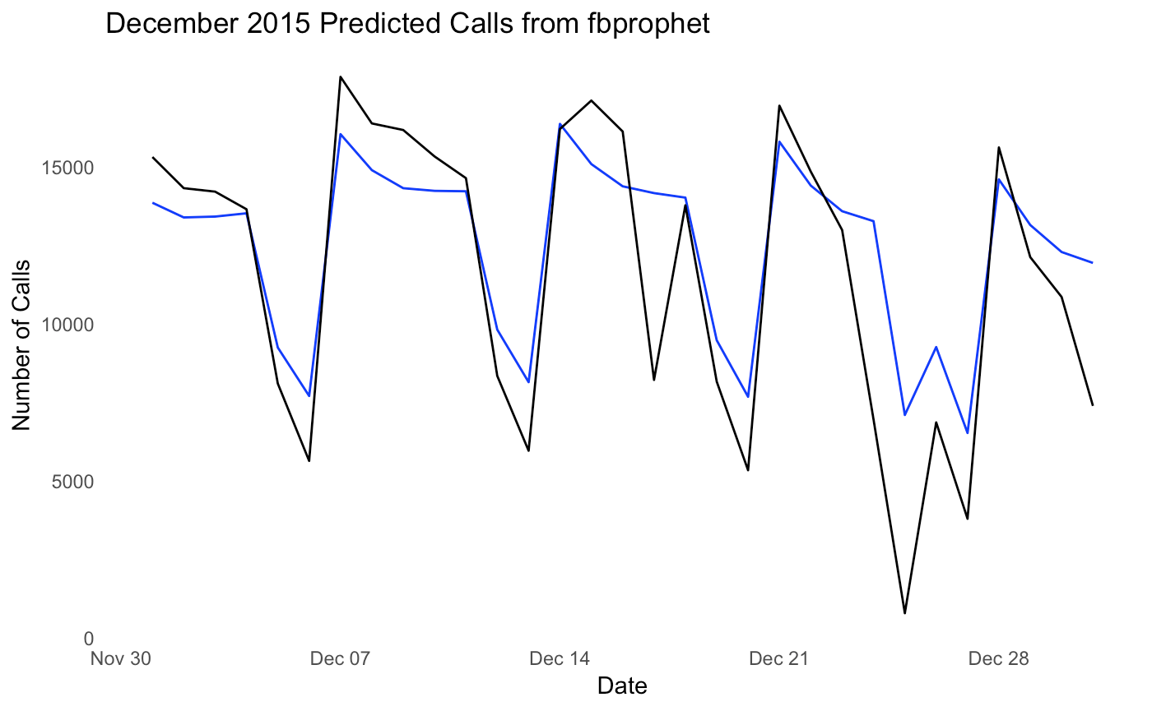
prophet model
Average daily call volume in Dec 2015 predicted using call volume from 2014
Black – actual call volume; Blue – predicted call volume

Slide 19
model comparison
Average daily call volume in 2015 predicted using call volume from 2014
Prophet Model outperforms the rest of the models
 | Mean Model | Naive Model yesterday | Naive Model last year | ARIMA Model | FB Prophet Model
Error (MAE) | 2,736 | 2,450 | 965 | 2,356 | 740
% Error (MAPE) | .57 | .42 | .18 | .29 | .15
Notes:
Error (RMSE)
3,285
3,685
1,556
3,257
1,250

Slide 20
result of final model
Average daily inbound call volume in 2016 predicted using call volume from 2014 & 2015
Best model obtained when only “Thanksgiving” and “Christmas” were considered as holidays with a window of (-7,7) days
Using the prophet model, predictions for inbound call volume for Q1 and Q2 of 2016 are off by an average of 576 calls (11%)

Slide 21
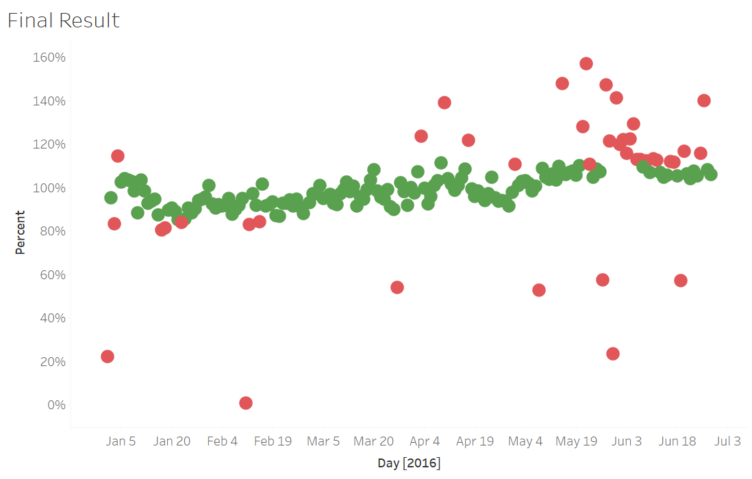
result of final model
Quality of Forecast – Prophet Model
Percentage error of predictions by day
Green – actual is within 85% - 110% of prediction
Red – actual is outside acceptable error range

Slide 22
summary
Objective : Facilitate scheduling by predicting inbound call volume
Result : Predictions for inbound call volume are off by an average of 576 calls (11%)
Thank you for the opportunity to work on this analytics project
Hand-off : Written Report, Presentation, R Code

Slide 23
questions

